Slide 1
Cascade Meadows
2024 Annual Meeting of Members
April 25, 2024

Slide 2
Management Report
2024 ANNUAL MEMBERS MEETING
What’s happened since we last met:
Peirce Enterprise was utilized for snow removal at the community during winter 2023-2024
The board and members of the community voted and approved to raise dues to $165 starting January 2024 followed by 8% increases through 2031, then stabilize at $260 per month
The board motioned to put a contract in place with Curtis Lawn Services for Landscaping for the 2024 year.
Pocket gophers have been found within the HOA areas. Bids have been requested and are under review.

Slide 3
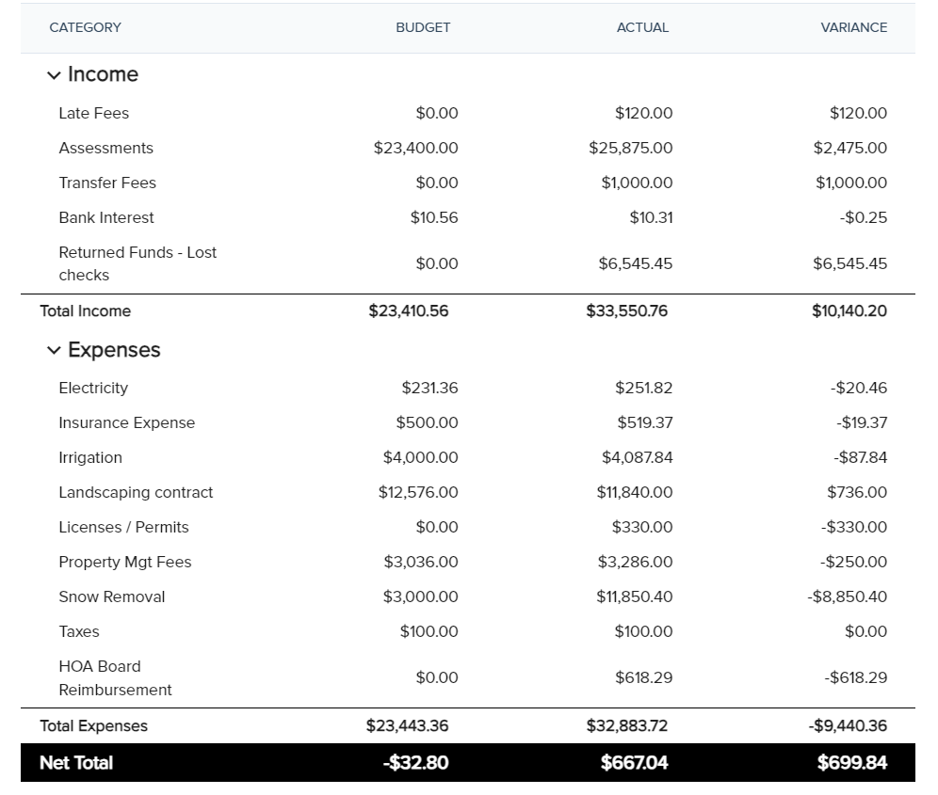
Financial Report: Budget vs. Actual 2023
2024 ANNUAL MEMBERS MEETING

Slide 4
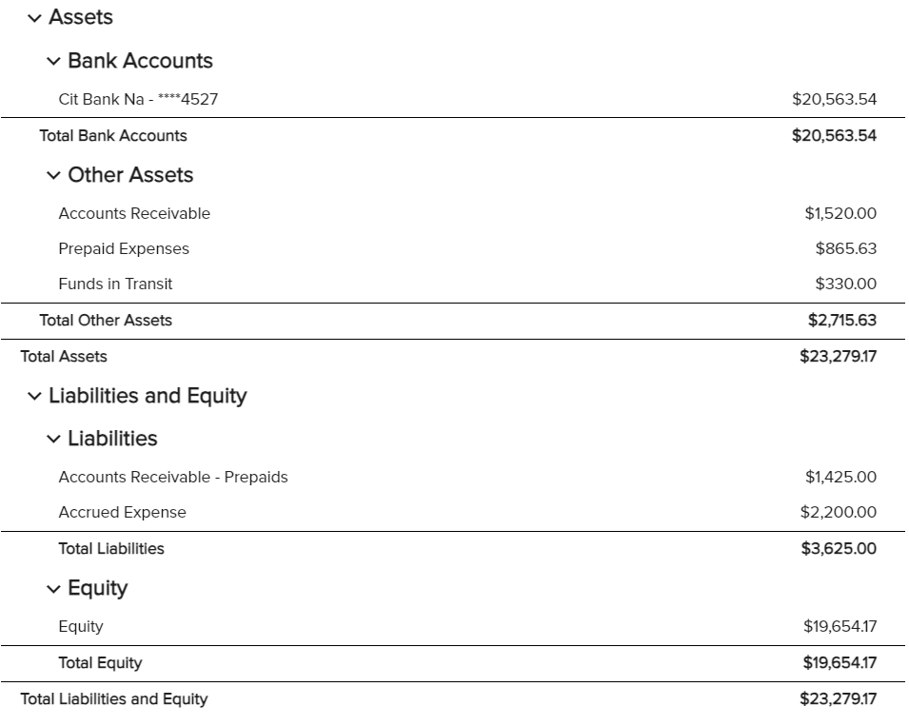
Financial Report: Balance Sheet 12/31/2023
2024 ANNUAL MEMBERS MEETING

Slide 5
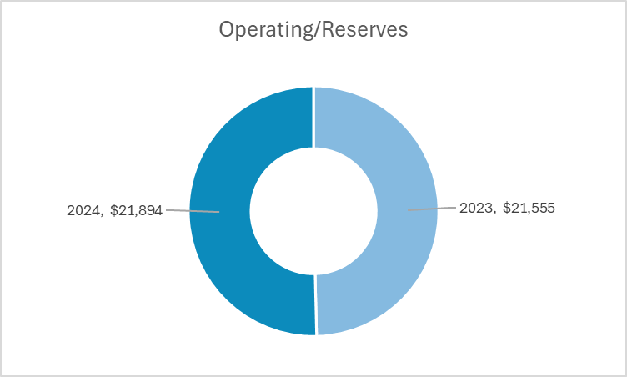
Financial Report: Reserve Snapshot
2024 ANNUAL MEMBERS MEETING
YTD: $23,178.61

Slide 6
2024 Budget Review
2024 ANNUAL MEMBERS MEETING
Total Spend
$25.6k

Slide 7
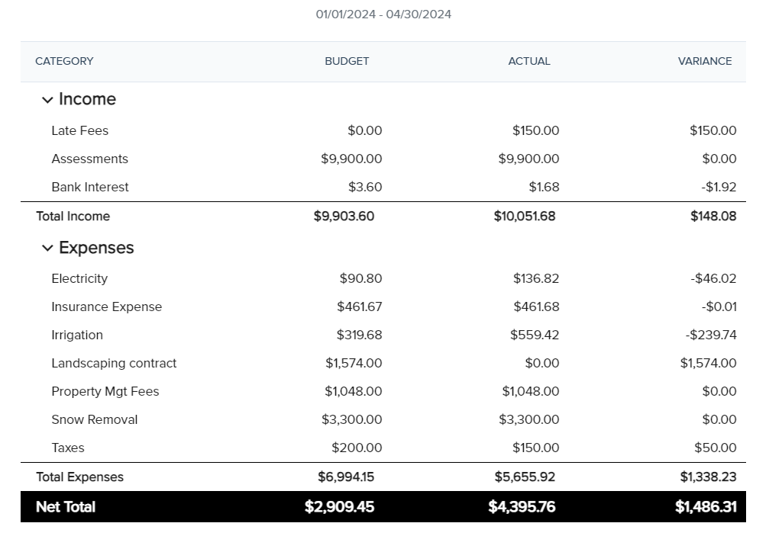
Budget Review: YTD Performance
2024 ANNUAL MEMBERS MEETING

Slide 8
CC&R Review
2024 ANNUAL MEMBERS MEETING
Architectural Projects: Form must be completed and submitted to the board for the architectural committee to approve. The AAC Application can be found on cascademeadowshoa.org
Trees: The planting of trees that will have a high profile and obstruct view from neighboring lots is prohibited. Such trees, at the discretion of the committee may be pruned or removed at the owner's expense.

Slide 9
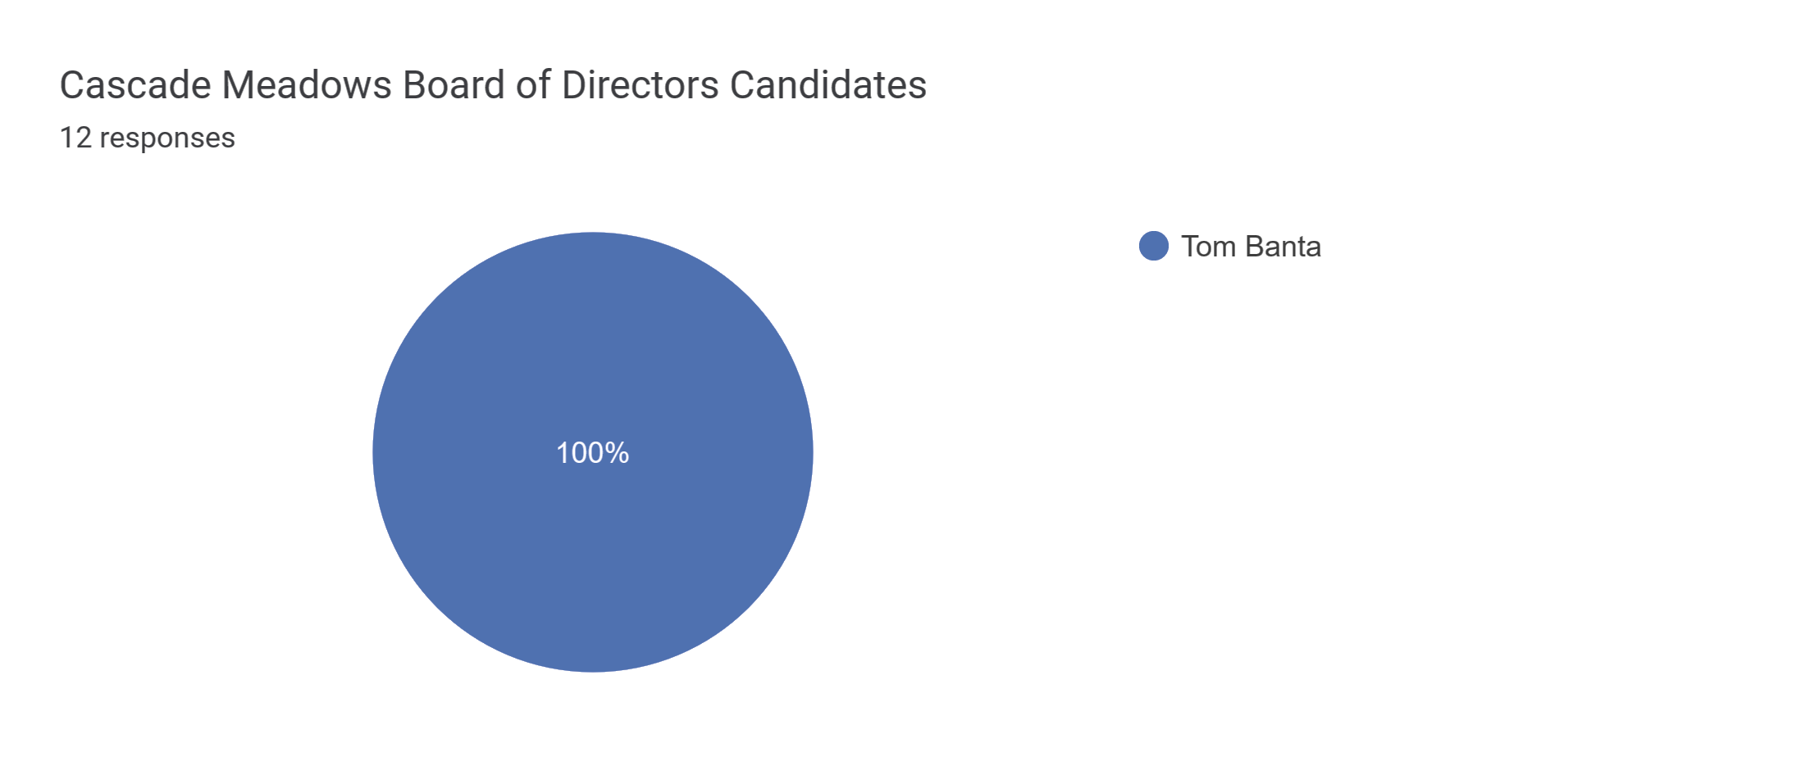
Election Results
2024 ANNUAL MEMBERS MEETING

